Slide 1


Slide 2
a blooming flower
a flower in full bloom(blossom) 鲜花盛开
The cherry blossom came out early in Washington this year. 花
unfold a map
unfolded her arms
The audience watched as the story unfolded before their eyes.
观众看着剧情逐渐地展开。
She unfolded her tale to us.
lay out a map

Slide 3
当我发现自己坐在校长的办公室里时，那个机会就出现了。
The chance unfolded as I found muself sitting in the headmaster’s office.
As the fog vanished, ______________________________________ (壮丽的景色在我们眼前展开)
unfold (v.) - fold (opp. v.) - folder (n.)
fold (up) the paper in two
fold (up) the table
fold the baby in the blanket
fold sb in one’s arms
the splendid scenery unfolded before our eyes.
Notes:
把婴儿裹在毯子里
拥抱某人，搂住某人

Slide 4
breathtaking /
impressive, splendid, spectacular, magnificent, amazing, stunning, awesome, astounding, striking
rich (adj.) - richness (n.) -
win the heart of sb 深受某人的喜爱
enrich (v.)
have something to offer 有东西可以提供
Canada has much to offer in terms of location and climate.
从位置和气候来说，加拿大可提供许多有利条件。

Slide 5
broad /
vast, great, huge, extensive, immense, spacious
ethnically diverse 民族多元
ethnic groups
ethnic tensions 种族紧张形势
ethnic clothes
an ethnic minority 少数民族
an ethnically divided region
种族分裂地区
族群
ethnic communities
具有民族特色的服装

Slide 6
distinct cultures 不同的文化 1) clearly different, unique
Country music is quite distinct from jazz.
The results of the survey fell into two distinct groups.
The outline of the building became more distinct.
a distinct smell of gas / His voice was quiet but every word was distinct.
Being tall gave Tony a distinct advantage.
2) 清晰的
3) 确切的优势 definite
Notes:
two distinct species

Slide 7
adv.
He could remember everything very distinctly.
n.
make/draw a distinction between A and B
a writer of distinction 优秀作家 the quality of being excellent
She graduated with distinction. 以优异成绩毕业
adj.
distinctive 独特的 characteristic
clothes with a distinctive style

Slide 8
【语境应用】单句语法填空。
Although they look similar, these plants are actually quite distinct __________ each other.
Before birth, babies can ______ ____ __________ ________ their mother’s voice and that of a female stranger. (能分辨)
The new law makes no distinction between adults and children.
这项新法规对成人和孩子同样适用。
from
make a distinction between

Slide 9
Mountains rose in the distance.
远处山峦叠起。
They carved their initials on the desk. 1) 刻，雕刻
The statue was carved out of a single piece of stone.
The wood had been carved into the shape of a flower.
carve the turkey 切块
carving n. 雕刻，雕刻品
a wood carving of a human hand 木雕
He succeeded in carving out a career in the media.
艰苦创业，奋斗取得(事业)

Slide 10
【语境应用】单句语法填空。
手工艺人会用石头、黏土 (clay) 或木头刻出他们的产品。
He carved _________ a name for himself in the engineering business.
Wood _________ (carve) began as a necessity in America and developed into an art.
Craftsmen would carve their products out of stone, clay or wood.
out
carving

Slide 11
1. Because mother is afraid we'll get lost, we aren't allowed to wander far.
2. It's easy to be distracted and let your attention wander.
3. The road wanders through the hills.
Notes:
游荡，走
走神
蜿蜒

Slide 12
1) a mighty warrior
威猛的斗士
2) the mighty Yellow River 浩荡的黄河
a land marked with vast lakes and mighty rivers
一片拥有大片湖泊和宽广河流的土地
grand, great, impressive, towering, high, powerful, huge, enormous, massive
He had given a mightily impressive performance. 印象深刻的
We have struggled mightily to avoid more losses. 艰苦努力
Notes:
strong & powerful
large & impressive

Slide 13
1. She was on the edge of tears.
2. Through superior production techniques they were able to gain the competitive edge.
3. My nerves were constantly on edge.
Notes:
她泪水盈眶。
优势
紧绷状态

Slide 14
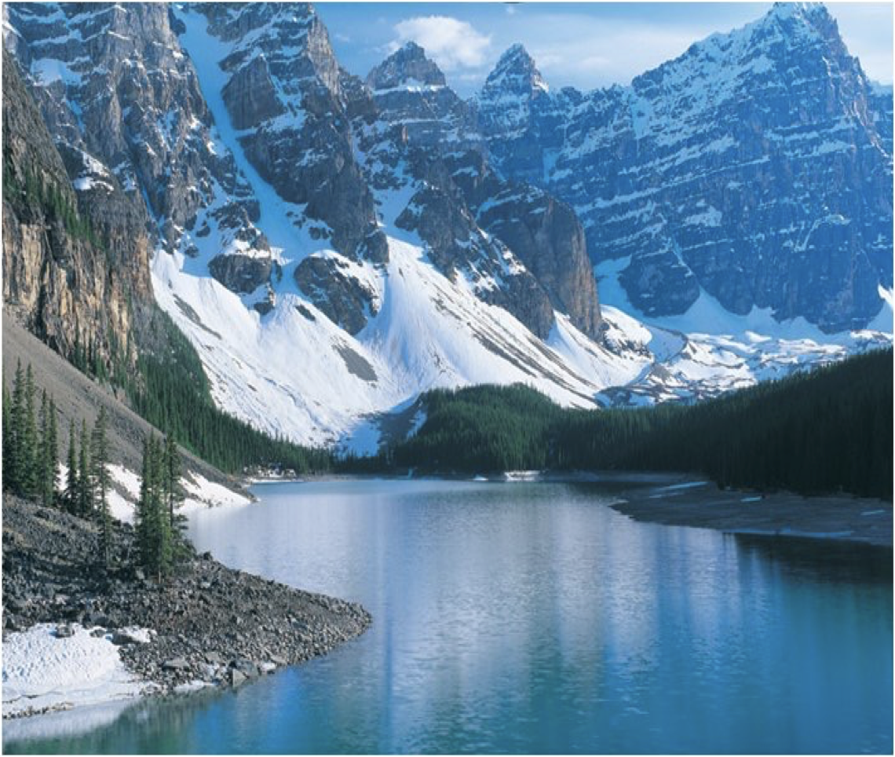
________ mountains
_______ forests
___________ lake
towering
thick
crystal-clear
snow-capped, spectacular...
dense, vast
shining
Notes:
她泪水盈眶。
优势
紧绷状态

Slide 15
中国就像大自然描绘的一幅惊人的艺术品，广袤的土地，壮丽的森林，清澈的湖泊，浩荡的河流和巍峨的山脉展示了它的独特和美丽，深受那些喜欢多元文化人们的青睐。
China is like a breathtaking artwork painted by Mother Nature,
with vast land, splendid forests, crystal-clear lakes, mighty rivers and towering mountains demonstrating its uniqueness and beauty to win the heart of those who enjoy what it has to offer.

Slide 16
I've finished the test apart from the last question.
除了最后一道题，这个测试我全做完了。except for
Apart from their house in London, they also have a villa in Spain.
他们在伦敦有一座房子，此外在西班牙还有一座别墅。 in addition to, as well as, besides

Slide 17
common ancestor of lizards and turtles
her ancestral home
Many of them are descendants of the original settlers.
他们中许多人都是早期移民的后裔。
indigenous (native)
the indigenous peoples/languages of the area/community
The kangaroo is indigenous to Australia. 原产于 be native to
Notes:
蜥蜴和龟的共同原种
她的祖居
该地区的本地人／语言 /土著社区

Slide 18
by means of 经由，通过……方式
交通工具
'Do you mind if I have a look?' 'By all means.'
She is by no means an inexperienced teacher.
settle
It's time you settled your differences with your father.
The problem remains ______________. (settle)
means of transport
to be settled
Notes:
当然
绝不

Slide 19
5. The major ethnic groups, for example, include the English, Scottish and French, while the minority groups include residents from Singapore and the Pacific Islands.
“while” is used to emphasize the difference between the two situations, activities, etc.
while作并列连词，表示对比，意为“然而”。
She is a night owl while her husband is an early bird.

Slide 20
【归纳】while的其它用法
1) While she was asleep, thieves broke in and stole her handbag. 时间状语从句
2) While we don’t agree with each other, we continue to be friends.
让步状语从句
Notes:
尽管

Slide 21
The plan was designed to help minorities improve their economic conditions.
minority languages 少数民族语言
ethnic/racial minorities 少数民族
Only a minority of young people like to listen to classical music. 少数的……
Women are __________________ (占少数) in the top rank of government.
majority n.
minor injuries
play a minor role in
be of minor importance
in a/the minority
minors n. 未成年人
It’s an offence to serve alcohol to minors.
Notes:
轻伤
在
重要性较小

Slide 22
Should you find yourself in one of these subcultures, languages, cuisine, architecture, art and music will define your encounter.
如果你发现自己置身于其中一种亚文化中，那么(它的)语言、饮食、建筑、艺术和音乐都会说明你邂逅的是何处文化。
should 置于句首，省略连词if，构成倒装。
Should anyone call (= if anyone should call), please tell them I’ll be back soon.
Notes:
真实条件句句 formal
should 可能发生

Slide 23
可以省略if的条件句，一般以had, were, should开头
如果他更努力，他就能通过考试。
Had he worked harder, he would have got through the exams.
如果她是我的朋友，我会向她寻求帮助。
Were she my friend, I would ask her for help.
如果明天下雨，我们将取消会议。
Should it rain tomorrow, we would stay at home.
*should可以引导真实条件句
_________________, your health care and other benefits will not be immediately cut off. 如果你被开除了
Should you be fired
Notes:
虚拟条件句、真实条件句

Slide 24
cuisine
authentic cuisine / traditional cuisine / local cuisine
地道料理 / 传统料理 / 本地料理
architectural adj.
a distinct architectural style of the town
architect n.
I had never encountered such resistance before.
confront/meet with
She was the most remarkable woman he had ever encountered.
come across/run into
a chance encounter
Notes:
遭遇（不快的事情）
偶然相遇
奇遇 an extraordinary encounter with ...

Slide 25
经济最活跃的地区
a dynamic and energetic leader
a dynamic personality 充满活力的个性
The market price is a dynamic element to consider in this study.
opp. static 静态的
He's one of the most dynamically imaginative jazz pianists.
The dynamic of the market demands constant change and adjustment.
The interchange of ideas aids an understanding of family dynamics. 家庭动态
Dynamics 力学，动力学
the most dynamic economic region
富有干劲、精力充沛的领导
Notes:
a dynamic economy
动态的，不断发展变化的
他是当下仍旧活跃的最有闯劲、最具想象力的爵士乐钢琴师之一
市场要有活力，需要不断地改变和调整。
a situation or group of people are the opposing forces within it that cause it to change.相互作用；动态

Slide 26
sample n.
The interviews were given to a random sample of students.
随机抽选出部分学生进行了采访。
a sample survey
a free sample of shampoo
v.
12% of the children ________ (sample) said they prefer cats to dogs.
I sampled the delights of Greek cooking for the first time.
sampled
Notes:
抽样调查
我第一次品尝了希腊烹饪的乐趣。
take samples of their blood

Slide 27
I know a nice place for a picnic that’s off the beaten track; hardly anyone goes there.
This is a design which gets off the beaten track.
了解…的动态
思路正确，做法对路
Director Yu Yang's animated sequel is on track to become China's top-grossing film of all time. 在正确的轨道上，有望
track and field
We set off once more, over a rough mountain track.
I followed him, tracking him in the snow until finally he got tired.
keep track of…
on the right track
Notes:
不了解……的进展
在路上

Slide 28
These colors won’t last if _______ _______ the sun.
exposure
Given /
considering, in view of / in the light of
Given that she is interested in children, ...
exposed to

Slide 29
(It’s) no/little/small wonder/surprise (that)...
Her letter came as a complete surprise.
万万没想到会收到她的信。
他们平安的消息给大家带来了莫大的安慰。
News of their safety ____ ____ __ _____ ____ ____ us all.
这个新闻会令很多记者感到震惊。
The news will ____ ___ ___ ____ __many journalists.
came as a great relief to
come as a shock to

Slide 30
the depths of the ocean 最深处
She was in the depths of despair.
她处于绝望的深渊。
He gazed into the depths of her eyes.
a writer of great wisdom and depth
洞察力，深刻
look at the report in depth 深入，详细
an in-depth study 深入研究

Slide 31
a blanket of fog/snow/cloud
The ground was soon blanketed with snow.
地面很快铺上了一层厚厚的积雪。
With a thick mist now blanketing the trees, I got thoroughly lost.
Notes:
此时浓雾笼罩着林木，我彻底迷路了。

